Slide 1

Radio Free Urbana (WRFU) Streaming
Tian sun

Slide 2
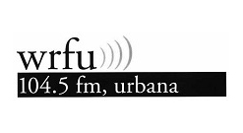
What is WRFU
WRFU "Radio Free Urbana" 104.5FM is a low power FM station broadcasting a variety music format in Urbana Illinois.
Its aim is to foster the creation and distribution of media and art that emphasizes underrepresented voices and perspectives.

Slide 3
About the Data
314455 rows with 20 columns
Each row representing a new stream
Collected from Jan 2nd, 2020 to Dec 25th, 2022
Nan Rates: 4.074%

Slide 4
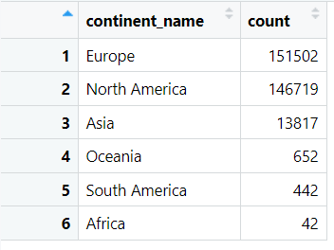
World Wide Distribution

Slide 5
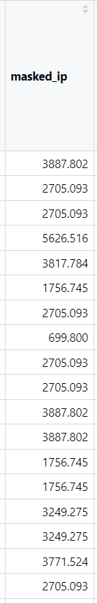
“Masked-IP”
Faked IP address to protect privacy.
Unique for each listener.

Slide 6
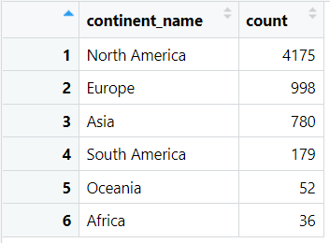
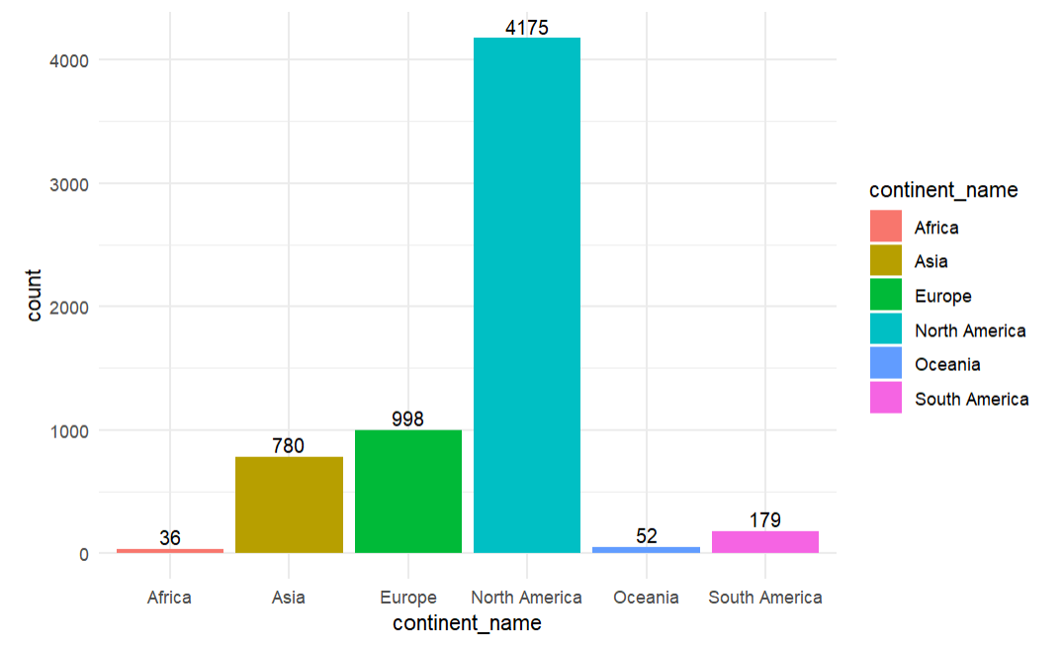
New World Wide Distribution

Slide 7
What happened from 151502 to 998?
Special Listener “2705.093”
387 streams.
0 minutes of listening.

Slide 8
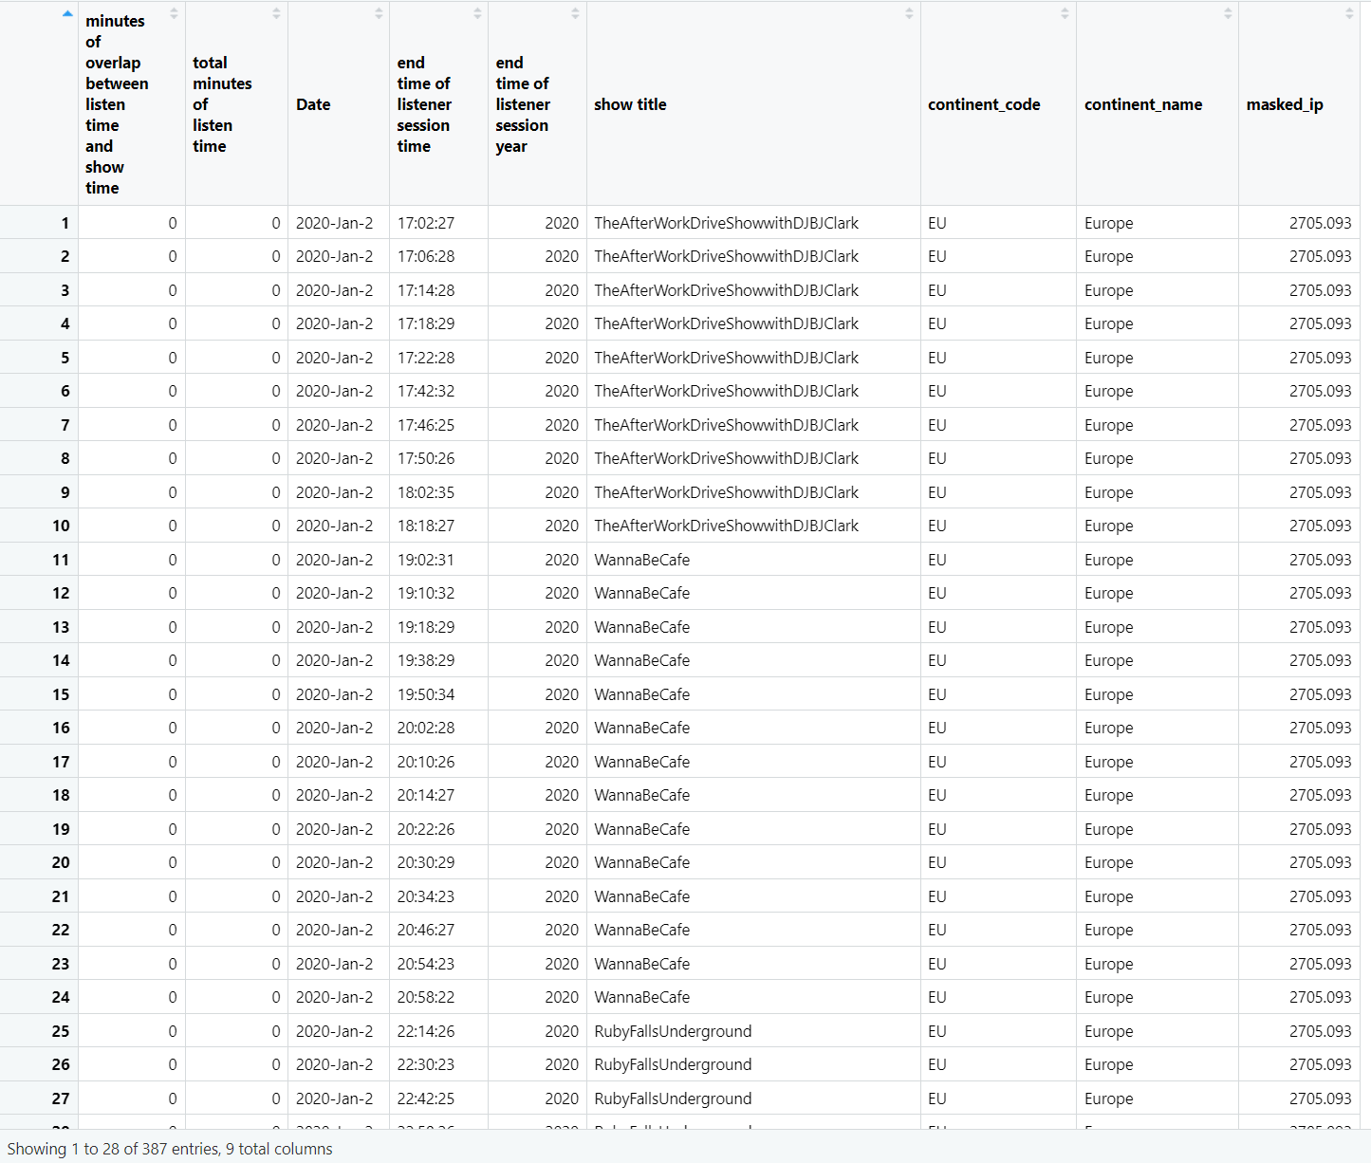

Slide 9
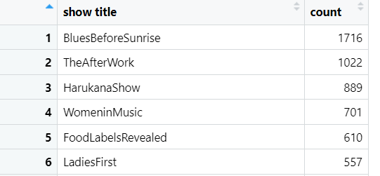
Most Popular Show
Top 6:
Blues Before Sunrise
The After Work
Harukana Show
Women in Music
Food Labels Revealed
Ladies First

Slide 10
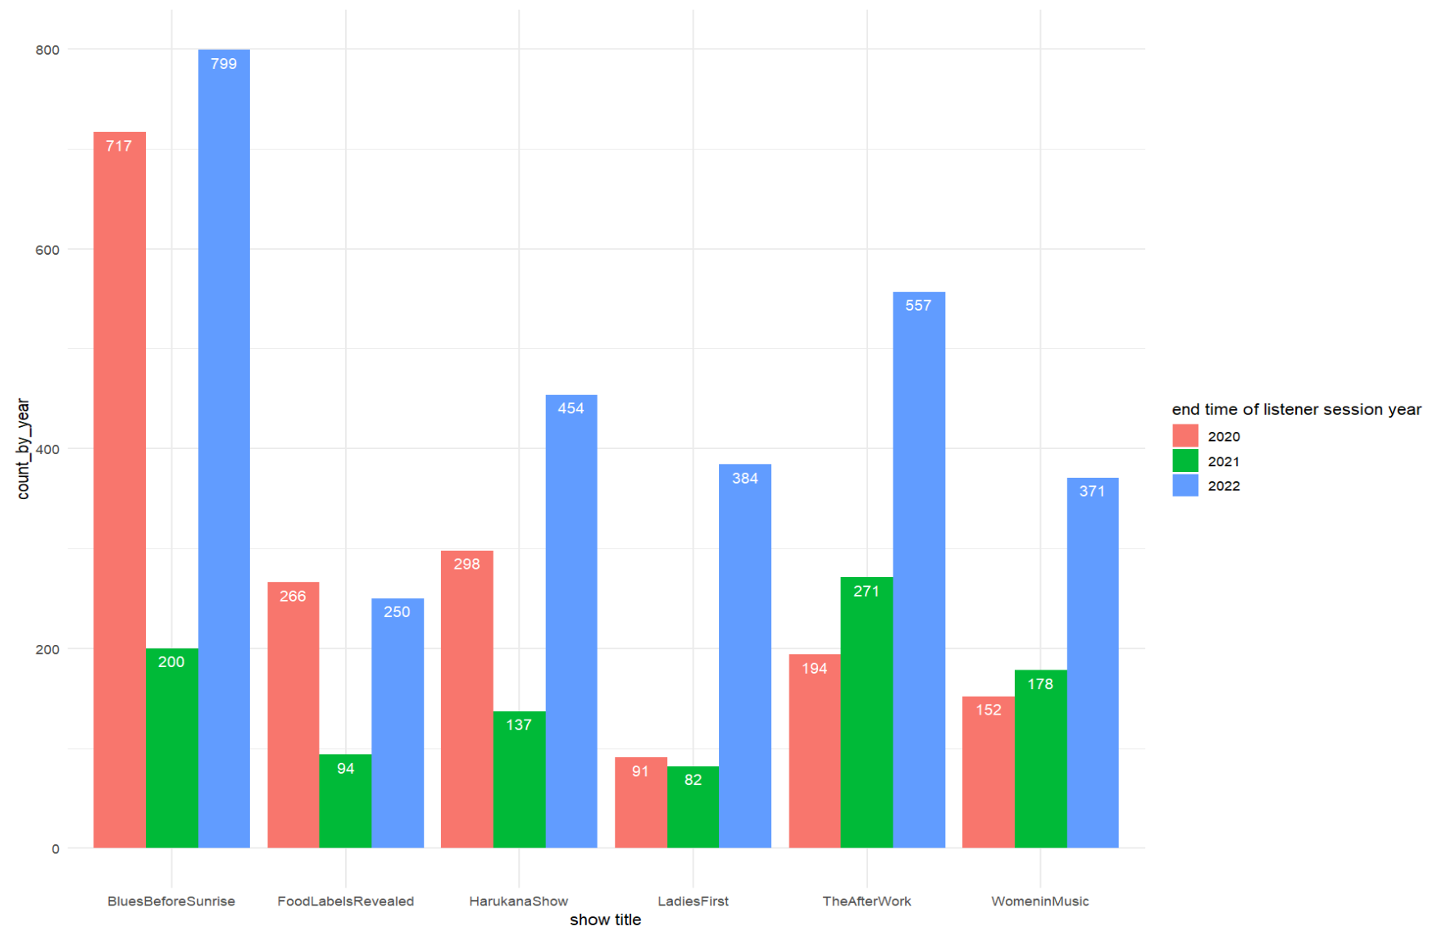
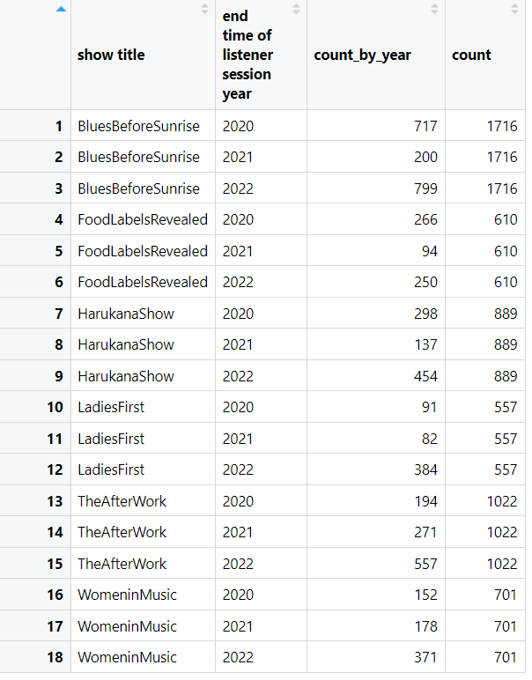
Visualization in Years

Slide 11
Summary
Kick out useless data, North America has the most listener.
Rank for the shows.
What happens in 2021, stays in 2021.

Slide 12
What’s next?
Models for actual minutes of listening.
How to improve WRFU.

Slide 13
Thank you!
Questions?

